Slide 1


Marketing and
Social Media
TEAM 4150

Slide 2

Marketing
Presenting your team professionally at competitions and with sponsors is essential to your team’s success.

Slide 3

Branding
Use consistent colors and logos to create a sense of unity and draw attention to your team.
Logos are important as they provide an image to associate with your team’s name.
At events, use the same colors and logos on t-shirts, posters, pins, etc.
FRobotics uses this logo and its colors on all of our t-shirts, banners, pins, documents, and social medias.

Slide 4
Mission Statement
Identify your team’s overarching goal and mission
Come up with a statement that encompasses your goals as a team
Work with your Outreach Coordinator to focus these goals in outreach events
Communicate your team’s overarching mission with team members, mentors, sponsors, and judges
Use this statement to unify the team’s actions in writing and in presentations

Slide 5
Reaching out to Sponsors
Reaching out to sponsors is key in terms of a team’s financial stability.
When approaching a potential sponsor, be respectful and confident. Make sure to show enthusiasm for FIRST.
Highlight the learning aspects of FRC, proving our promise for furthering STEM in the future.
It is most effective to present to sponsors in person.
Offer to bring your robot and a few team members to the business.
If the potential sponsors prefer, phone calls are another method to get in touch. Write a general script that students can use when speaking over the phone.
Reaching out through social media, letters, and emails are also options when looking for sponsors.

Slide 6

Social Media
Social media is very important for team recognition within the FIRST community as well as your team’s local community.

Slide 7

Platforms
Get your team on as many popular platforms as possible! This gives you a larger audience and a greater chance of recognition.
Instagram, Twitter, Facebook, Youtube
Keep branding consistent across all platforms
Profile pictures, usernames
Include your team name and number so you’re easier to find
FRobotics is @frobotics4150 on Instagram, Twitter, and Facebook. This is our profile picture on all platforms.

Slide 8
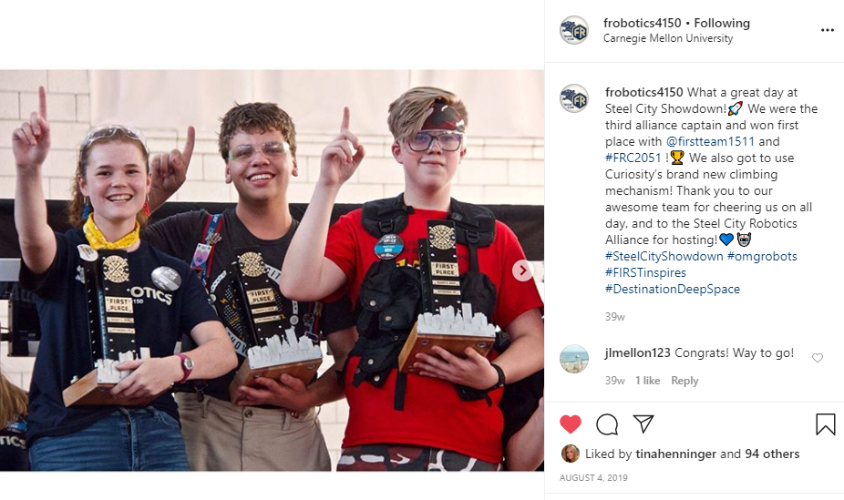
When to Post
During and after competitions
Interact with and tag teams from your alliance, congratulate the winning teams, etc.
FRobotics Instagram post after the 2019 Steel City Showdown competition.

Slide 9
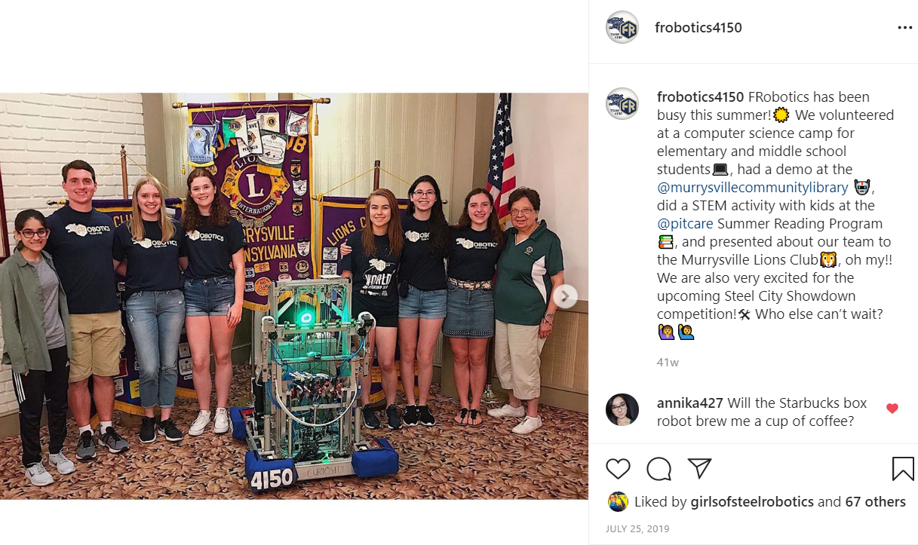
When to Post continued
Before or after outreach events to announce the team’s appearance or show off what you accomplished
Tag the location, group, or company your event was with
FRobotics Instagram post after several outreach events in 2019.

Slide 10
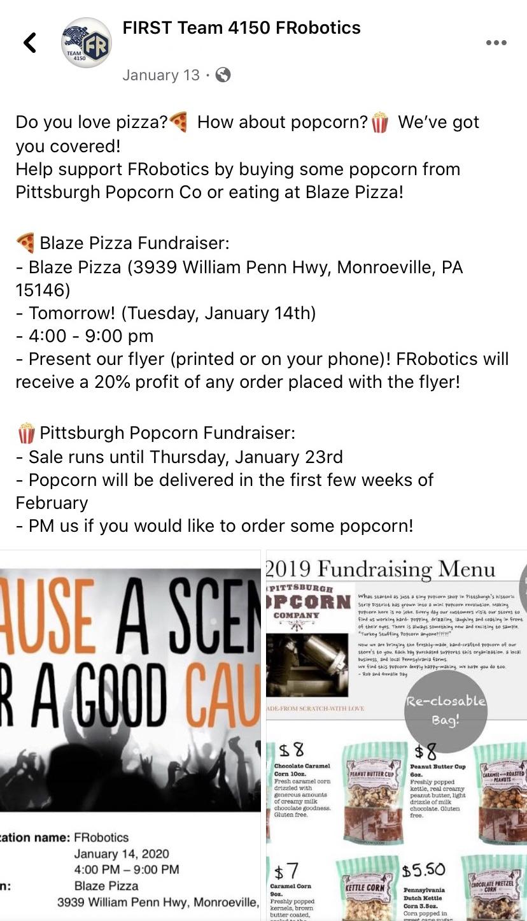
When to Post continued
During team fundraisers
Get the word out to your community to help you raise money
FRobotics Facebook post announcing fundraisers.

Slide 11
Tips for Posting
Tag sponsors, potential sponsors, and school administrators (if applicable to your team) to show them what your team is up to
Utilize hashtags!
#omgrobots and other FIRST hashtags will get your posts to more people
Put some effort into each post
A good post takes time to create, but it will get more likes if it’s exciting and aesthetically pleasing!

Slide 12
Credits
This lesson was written by FRC 4150 in partnership with FRC 8027 for FRCTutorials.com
You can contact the author at froboticsteam4150@gmail.com.
More lessons for FIRST Robotics Competition are available at www.FRCtutorials.com
This work is licensed under a
Creative Commons Attribution-NonCommercial-ShareAlike 4.0 International License.

